Slide 1
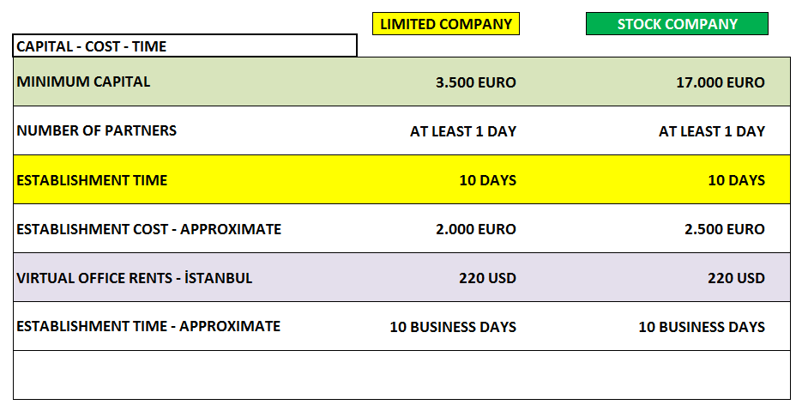
ESTABLISHMENT PROCEDURES & MAP

Slide 2
NECESSARY INFORMATION ABOUT COMPANY ESTABLISHMENT
TITLE OF THE COMPANY
* IN COMPANY TITLE, NAME OF THE CITIES CAN BE ADDITINALY MENTIONED
* SECTOR NEEDS TO BE MENTIONED IN THE COMPANY TITLE
* USAGE OF TURK - TURKISH DICTIONARIES IN THE COMPANY TITLE DEPENDS ON THE COUNCIL OF MINISTERS

Slide 3
NECESSARY INFORMATION ABOUT COMPANY ESTABLISHMENT
PARTNER & MANAGER
* A FOREIGN COMPANY CAN BE THE ONLY PARTNER OR ONE OF THE PARTNERS OF A COMPANY ESTABLISHED IN TURKEY.
* A FOREIGN REAL PERSON CAN BE THE PARTNER BY HIMSELF.
* A FOREIGN REAL PERSON CAN BE THE MANAGER BY HIMSELF.
* A FOREIGN REAL PERSON OR A FOREIGN COMPANY CAN BE IN THE
MANAGEMENT BOARD OF THE COMPANY IN TURKEY.

Slide 4
NECESSARY INFORMATION ABOUT COMPANY ESTABLISHMENT
ADDRESS
* EVERY COMPANY NEEDS A LEGAL ADDRESS.
* IF WANTED, A VIRTUAL OFFICE CAN BE CHOSEN AS THE LEGAL ADDRESS OF THE COMPANY. MONTHLY COST OF IT IS NEARLY 150 EUR.
* RENTS ARE AROUND 500 - 700 EUR. THE DIFFERENCE DEPENDS ON THE AREA.

Slide 5
NECESSARY INFORMATION ABOUT COMPANY ESTABLISHMENT
CAPITAL
* THE MINIMUM CAPITAL OF THE LIMITED COMPANIES IS 3.500 EUR..
* THE MINIMUM CAPITAL OF THE STOCK COMPANIES IS 17.000 EUR.
* 25% OF THE CAPITAL BLOCKED TO BANK BEFORE ESTABLISHMENT. AFTER 10 DAYS, IT CAN BE TAKEN FROM BANK AND CAN BE USED.
* THE REST OF THE CAPITAL, IN OTHER WORDS THE 75% OF THE CAPITAL NEEDS TO BE PAID TO COMPANY'S BANK ACCOUNT WITHIN 2 YEARS AFTER THE ESTABLISHMENT.

Slide 6
NECESSARY INFORMATION ABOUT COMPANY ESTABLISHMENT
TAX & SOCIAL SECURITY
CORPORATE TAX RATE: %20
* PROFIT DISTRIBUTION TAX: %15 (THERE WON'T BE ANY PAYMENT WITHOUT PROFIT DISTRIBUTION)
* IF THE COMPANY MAKES A LOSS, IT CAN BE SET-OFF FROM IT'S PROFITS IN THE COMING 5 YEARS
* VAT RATE: %18 (FOR SOME GOODS %8 - %1)
* MONTHLY GROSS MINIMUM WAGE: 350 EURO
* THE TOTAL COST OF THE MONTHLY GROSS MINIMUM WAGE INCLUDING FEE, TO THE EMPLOYER: 480 EURO

Slide 7
NECESSARY INFORMATION ABOUT COMPANY ESTABLISHMENT
NECESSARY INFORMATION BEFORE COMPANY ESTABLISHMENT
Passport
Photo (For Real Partner)
The officially approved/stamped and signed document showing the registry
record taken from official chamber of commerce
The decision from Slovenian Shareholders’s general assembley
The power of attorney for establishing the company.

